Slide 1
Lecture 34

Slide 2
Question 123.11.4
You put a gas in a cylinder with a piston through a process that changes the temperature. Can Q = 0?
Yes, if it is the right process
No
Maybe

Slide 3
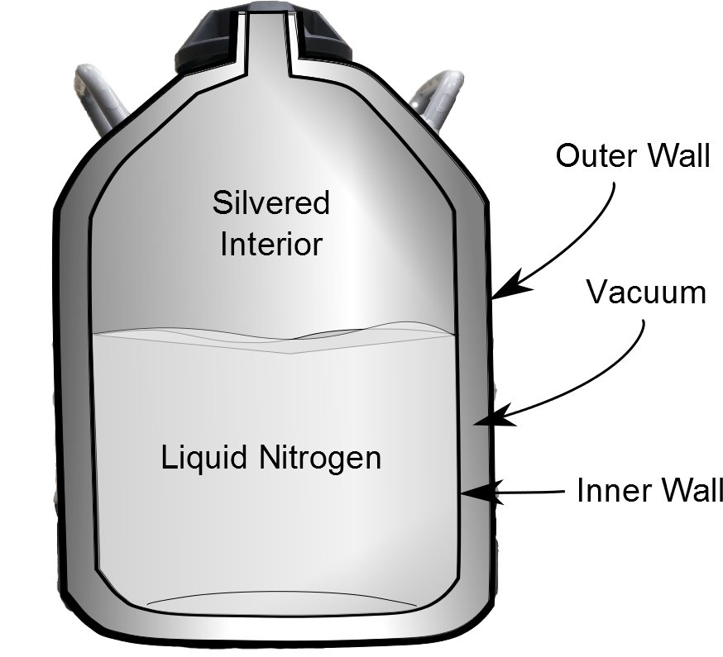
Silvered Interior
filled with gas
Outer Wall
Vacuum
Inner Wall

Slide 4
Question 123.11.4
We can have a process where Q = 0? What do we call that process?
Isobaric
Isochoric
Adiabatic
Isothermal

Slide 6

Question
For an adiabatic path, how does P depend on V?
$P=\frac{nRT}{V}$
$P=\frac{V}{nRT}$
$P=\frac{C}{V^{γ}}$
P is a constant

Slide 8

Question
Which of the following is true?
$a\ln{b=\ln{b^{a}}}$
$\ln{a+\ln{b}=\ln{ab}}$
$\ln{house=cabin}$
I don’t remember anything about log functions

Slide 9
Question
If I add two constants, is the result still constant?
Yes
No
Maybe

Slide 10
Question
Why do we like conservation laws in physics?
They tell us how the universe works
They make everything easy to understand
They make solving problems easier

Slide 11
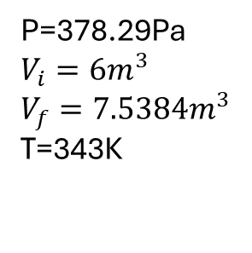
Suppose we change 1mol of an ideal gas from one state to another by two different paths. The two paths are shown in the figure (one is red and one is blue).
Find the work done in the two different paths.
P=378.29Pa
$$V_{i}=6m^{3}$$
$$V_{f}=7.5384m^{3}$$
T=343K

Slide 12
Δx
v
A

Slide 13


Sound Wave In
Sound Wave Out
A
$ρ_{in},v_{in},T_{in}$
$ρ_{out},v_{out},T_{out}$
Parcel of Air

Slide 14
P
dz
P
P+dP
dy
dx

Slide 15
END

Slide 16

Vacuum
Membrane
Membrane
Gas at T_{i}
Gas at T_{i}

Slide 18
Question 123.10.7
The initial state of a system is shown, if the membrane is broken, the gas fills the entire container. Is there work done by the gas in filling the container?
Yes
No
Can’t Tell
Vacuum
Membrane
Gas at T_{i}

